Slide 1

Customer Shopping Behavior Analysis
This project analyzes customer shopping behavior using transactional data from 3,900 purchases. Our goal is to uncover insights into spending patterns, customer segments, product preferences, and subscription behavior to guide strategic business decisions.

Slide 2



Project Overview & Dataset Summary
Project Goal
Dataset at a Glance
Uncover insights into spending patterns, customer segments, product preferences, and subscription behavior to guide strategic business decisions.
Rows: 3,900 purchases
Columns: 18 key features
Key Features: Demographics, purchase details, shopping behavior
Missing Data: 37 values in Review Rating

Slide 3

Exploratory Data Analysis (EDA) in Python
1
2
3
Data Loading & Exploration
Missing Data Handling
Column Standardization
Imputed missing values in 'Review Rating' using the median rating of each product category.
Renamed columns to snake_case for improved readability and documentation.
Imported dataset using pandas and performed initial exploration with df.info() and .describe().
4
5
Feature Engineering
Database Integration
Created age_group and purchase_frequency_days columns for deeper analysis.
Loaded cleaned DataFrame into PostgreSQL for SQL analysis.

Slide 4







Key Insights from SQL Analysis
Revenue by Gender
High-Spending Discount Users
Male customers generated significantly more revenue ($157,890) than female customers ($75,191).
839 customers used discounts but still spent above the average purchase amount.
Top 5 Products by Rating
Gloves, Sandals, Boots, Hat, and Skirt had the highest average review ratings.

Slide 5
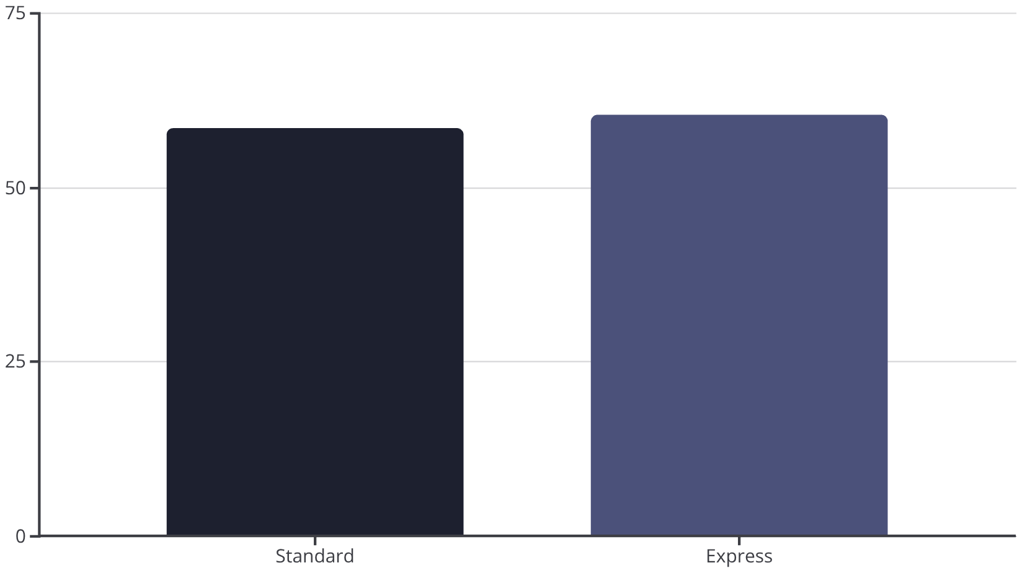
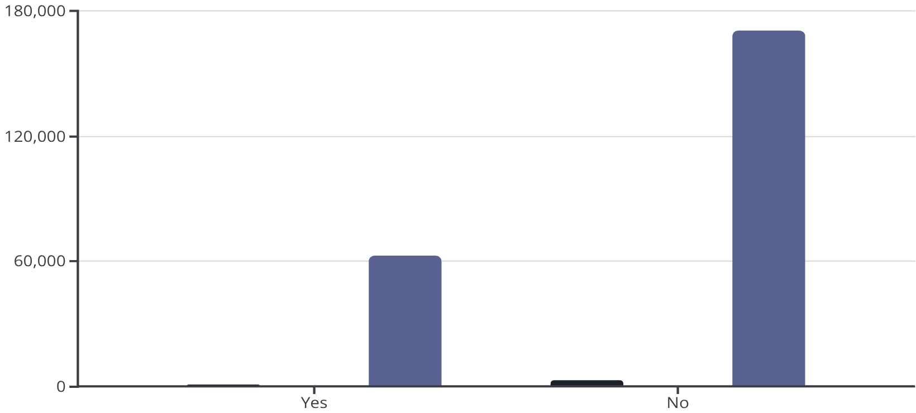
Shipping & Subscription Impact
Shipping Type Comparison
Subscribers vs. Non-Subscribers
Total Customers
Avg Spend
Total Revenue
Express shipping users have a slightly higher average purchase amount.
Non-subscribers contribute more to total revenue due to higher numbers, despite similar average spend.

Slide 6

Discount & Product Performance
Discount-Dependent Products
Top Products per Category
Hat: 50.00% discounted purchases
Accessories: Jewelry, Sunglasses, Belt
Sneakers: 49.66% discounted purchases
Clothing: Blouse, Pants, Shirt
Footwear: Sandals, Shoes, Sneakers
Coat: 49.07% discounted purchases
Outerwear: Jacket, Coat
Sweater: 48.17% discounted purchases
Identified the most purchased items within each product category.
Pants: 47.37% discounted purchases
These products show the highest percentage of purchases with discounts applied.

Slide 7

Customer Segmentation
Loyal Customers
Returning Customers
3,116 customers, indicating a strong base of repeat buyers.
701 customers, showing potential for increased loyalty.
New Customers
83 customers, representing opportunities for growth.
Customers were classified into New, Returning, and Loyal segments based on their purchase history.

Slide 8
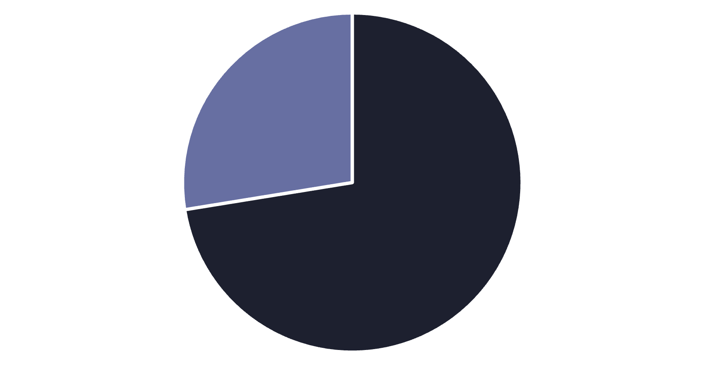
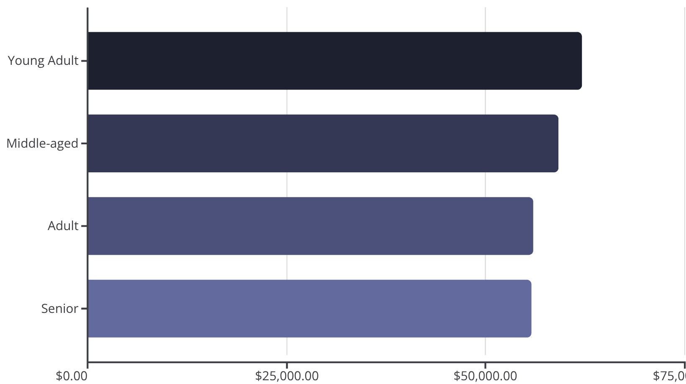
Repeat Buyers & Age Group Revenue
Repeat Buyers & Subscriptions
Revenue by Age Group
No
Yes
Customers with more than 5 purchases are more likely to subscribe.
Young Adults contribute the highest total revenue.

Slide 9
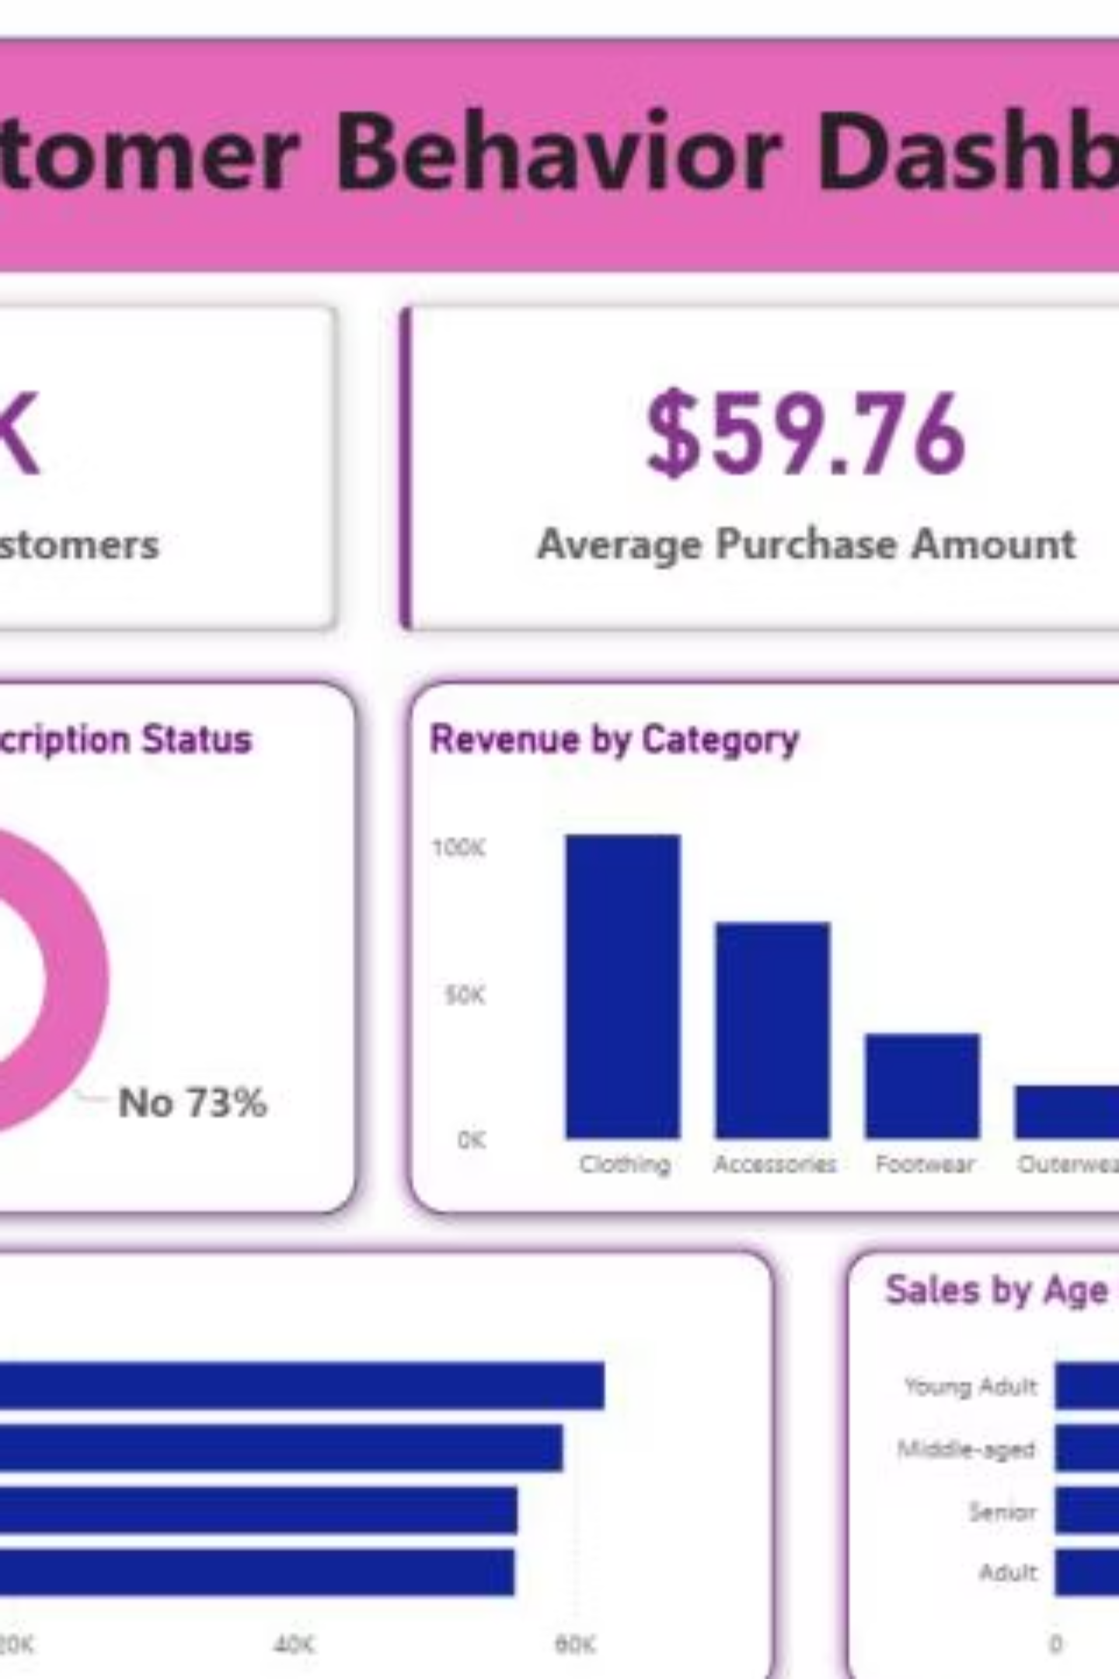
Interactive Power BI Dashboard
The dashboard features a sidebar with filters for Subscription Status, Gender, Category, and Shipping Type. It visualizes key metrics like customer count, average purchase amount, review ratings, and revenue/sales by category and age group.

Slide 10

Strategic Business Recommendations
Boost Subscriptions
Promote exclusive benefits to increase subscriber base and retention.
Customer Loyalty Programs
Reward repeat buyers to foster loyalty and move them into the "Loyal" segment.
Review Discount Policy
Optimize discount strategies to balance sales boosts with profit margins.
Product Positioning
Highlight top-rated and best-selling products in marketing campaigns.
Targeted Marketing
Focus efforts on high-revenue age groups and express-shipping users for maximum impact.

